Slide 1




Climate Change and its Impact on Health
The Team
Vikram Sunil Bajaj (vsb259) MS, Computer Science
Titash Mandal (tm2761) MS, Computer Science
Ameya Shanbhag (avs431) MS, Computer Science

Slide 2
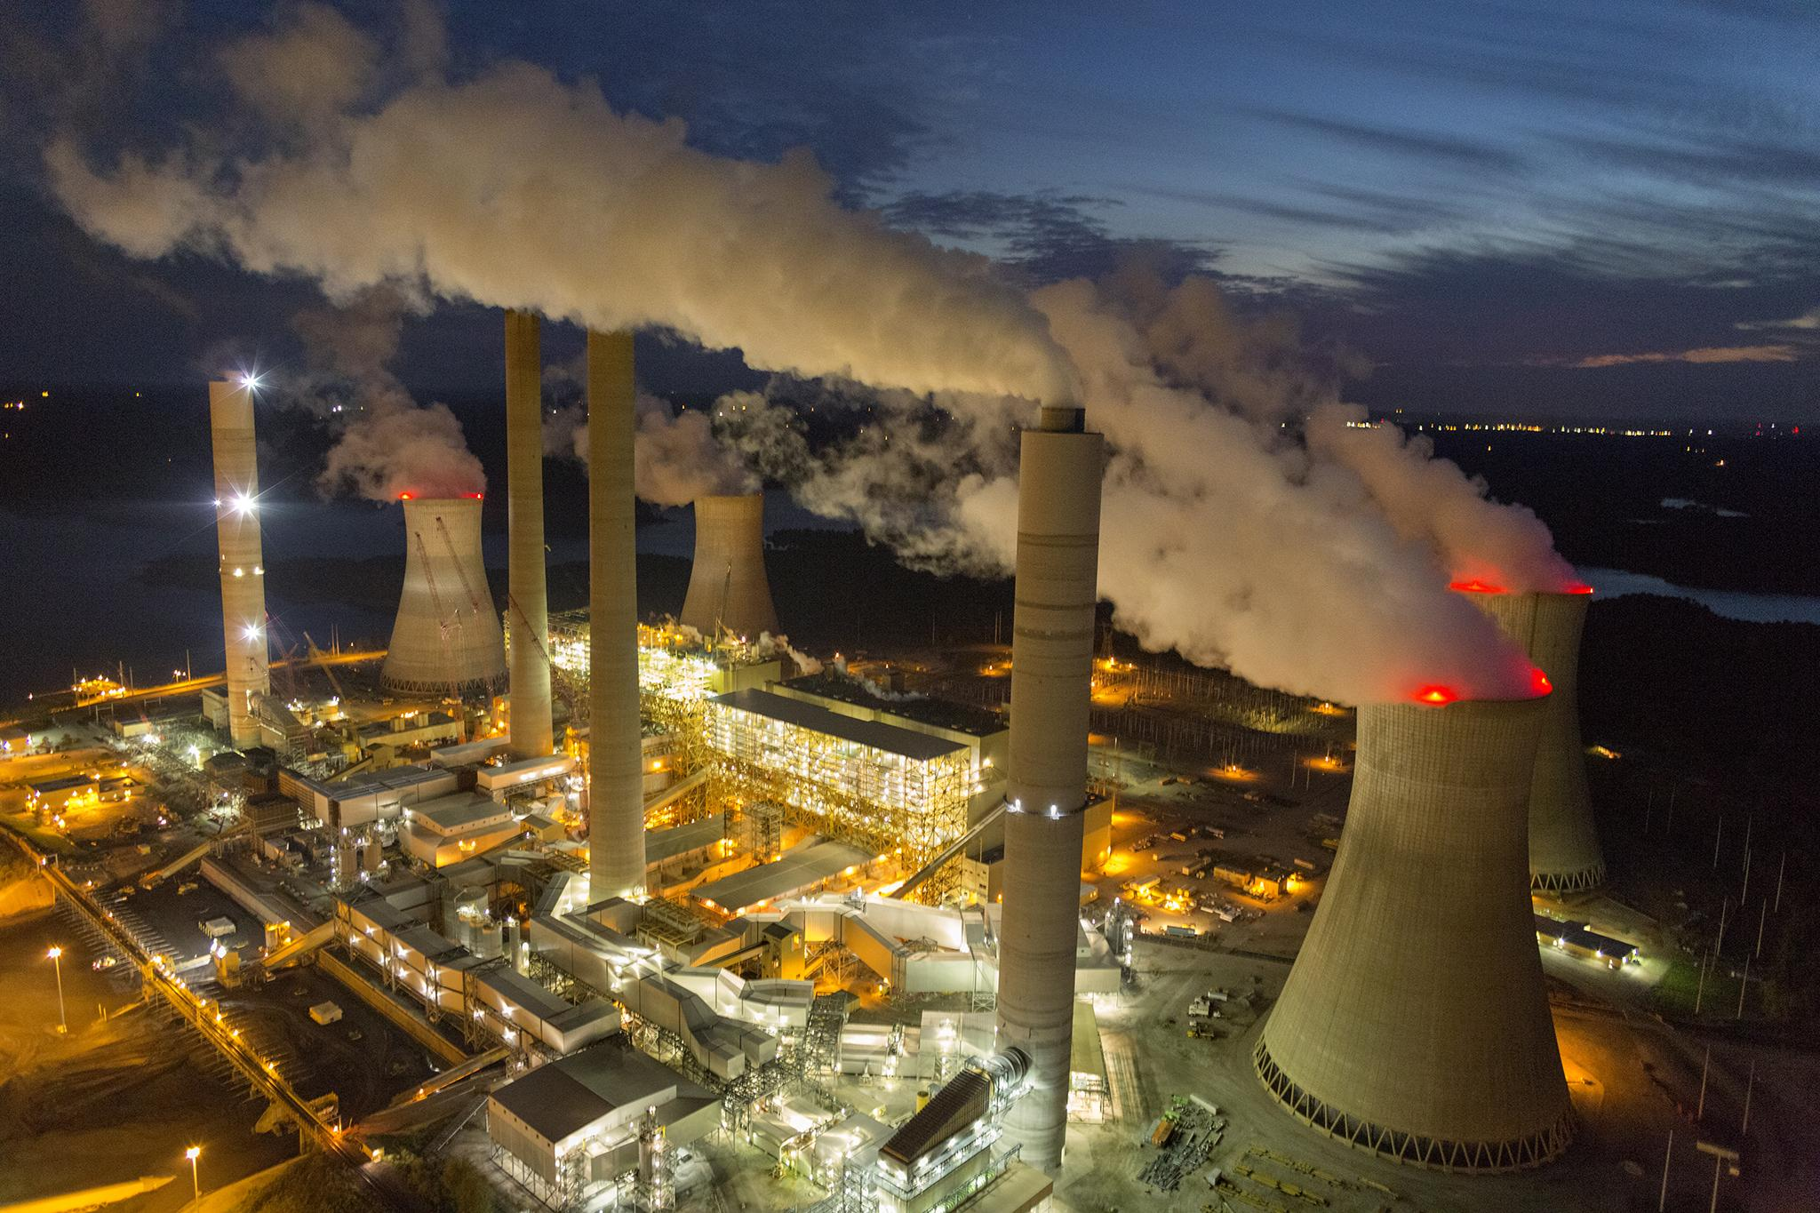
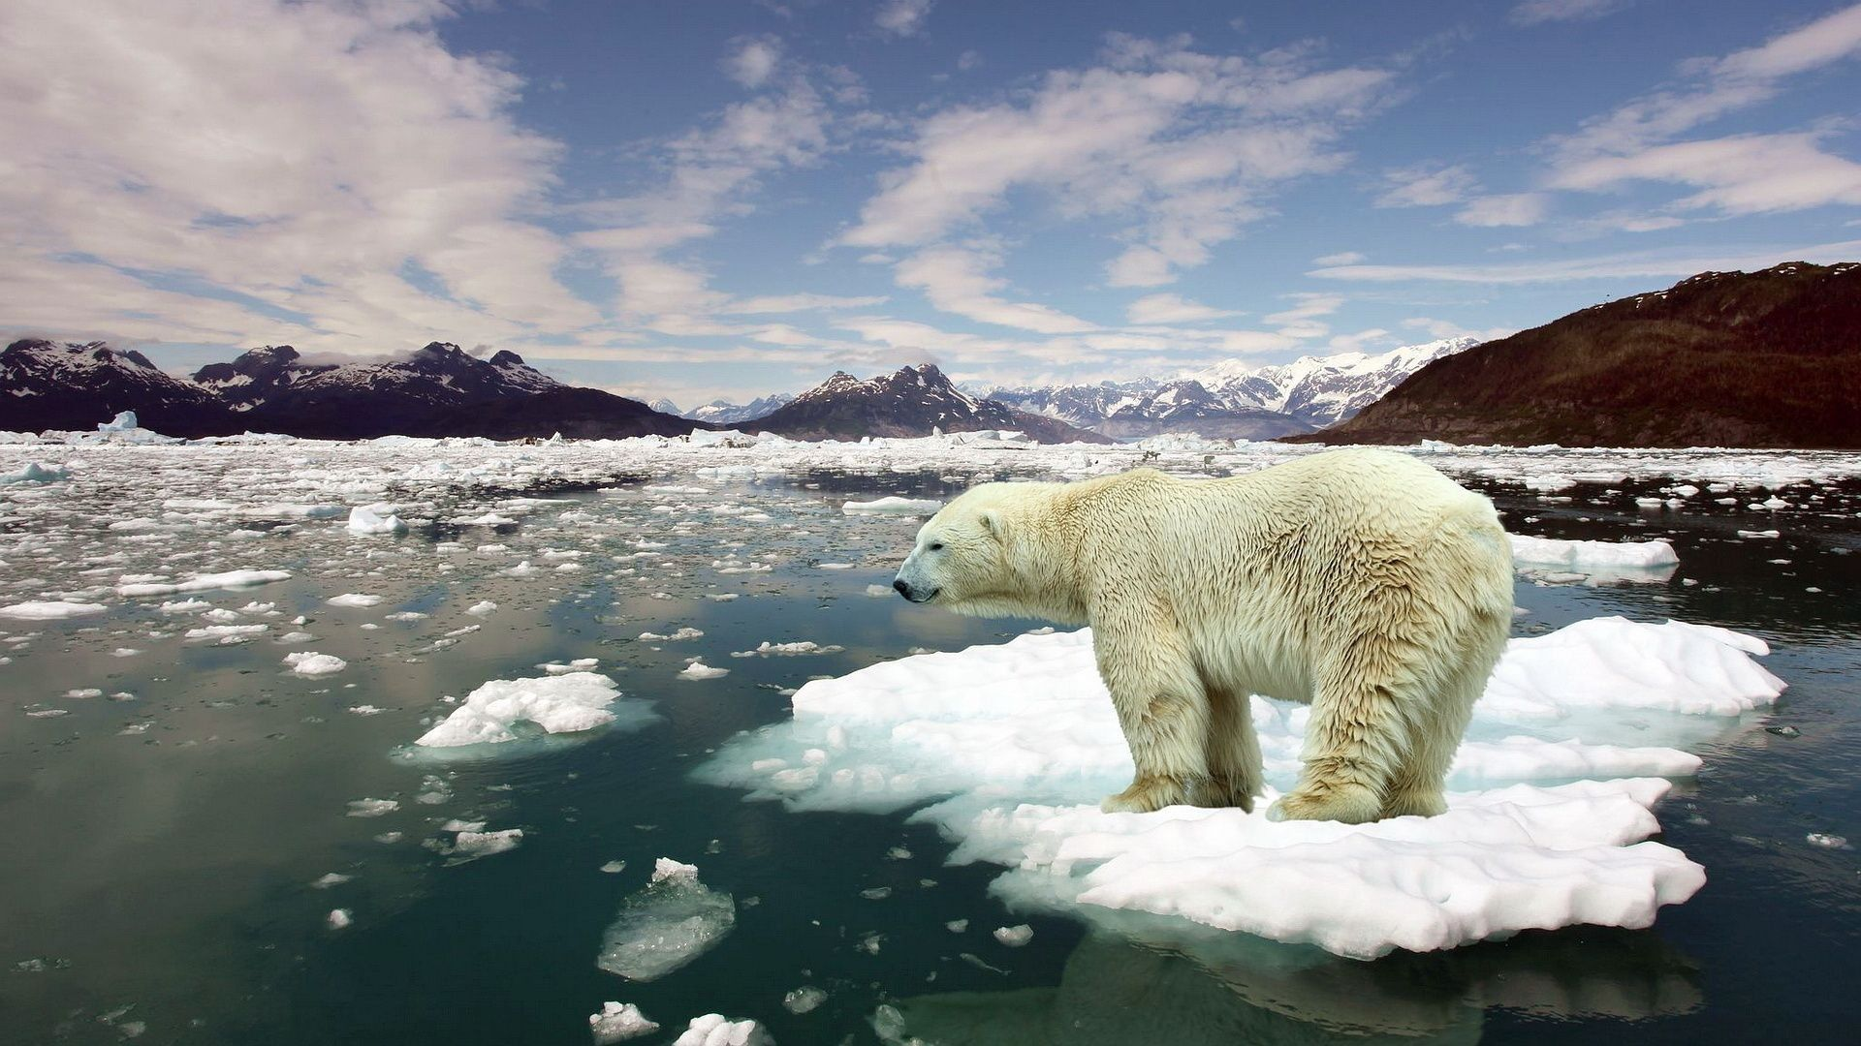
MOTIVATION / PROBLEM STATEMENT
In the past 100 years, the global average temperature has risen by about 0.74 degrees Celsius (34 Fahrenheit).
We wanted to analyze climate change and its impact on the environment by using the available Big data technologies.

Slide 3








PROJECT PIPELINE STRUCTURE
MACHINE LEARNING
DATA CLEANING
DATA QUERYING
DATA ANALYSIS
VISUALIZATIONS

Slide 4
DATA SOURCE
GLOBAL LAND TEMPERATURE
DATA SET
DEATHS DUE TO DISEASES
DATA SET
POLLUTION DATA SET
We used spark to analyze the levels of major air pollutants namely NO2, SO2, CO, O3 present in the atmosphere in different cities in USA.
In order to explain the effect of air pollutants we decided to explore the Land Temperature dataset which further gave us many interesting findings.
Finally we linked our combined dataset of pollutants and temperature to a third dataset of deaths due to diseases. This helped us gain deeper insights into the correlations between Pollution, Temperature and Health Impacts.
The AQI is an index for reporting daily air quality. It tells you how clean or polluted your air is, and what associated health effects might be a concern for you.

Slide 5
We identified the AQI levels of different gases which are harmful for the atmosphere.
Using Decision Tree Classifier to predict the future temperature values based on pollution level.
Plotting the real time twitter data streaming to monitor changes in sentiment with respect to climate change.
STEP - 1
STEP -2
STEP - 3
STEP - 4
STEP -5
Analyzing the yearly effect of pollutants on number of Deaths for each disease.
Correlating Temperature and deaths with Pollution dataset.

Slide 6
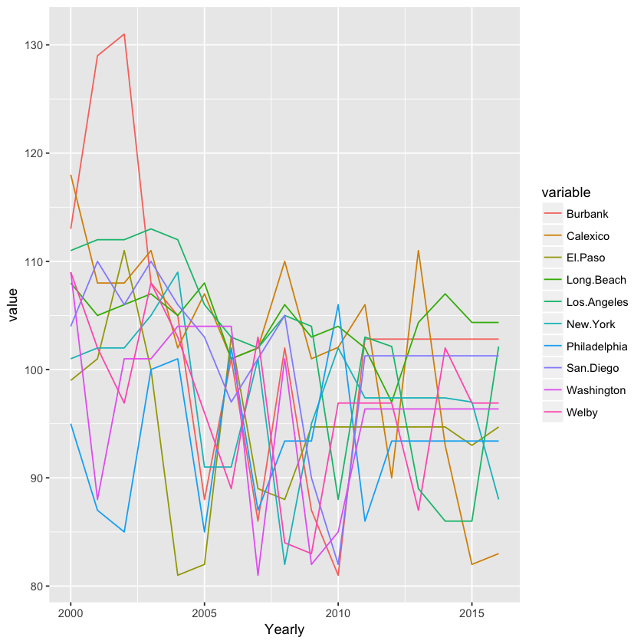
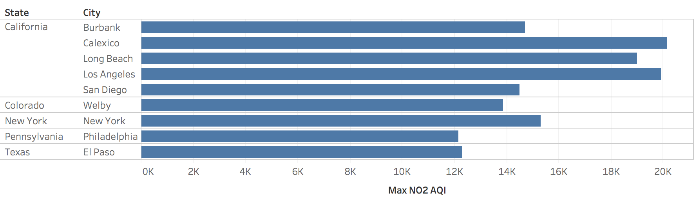
Objective
THE MOST POLLUTED STATES AND CITIES BASED ON NO2 AQI VALUES.

Slide 7
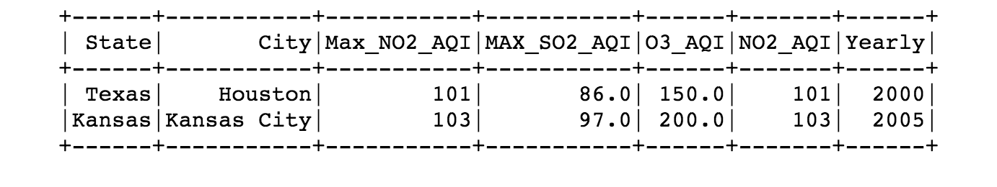
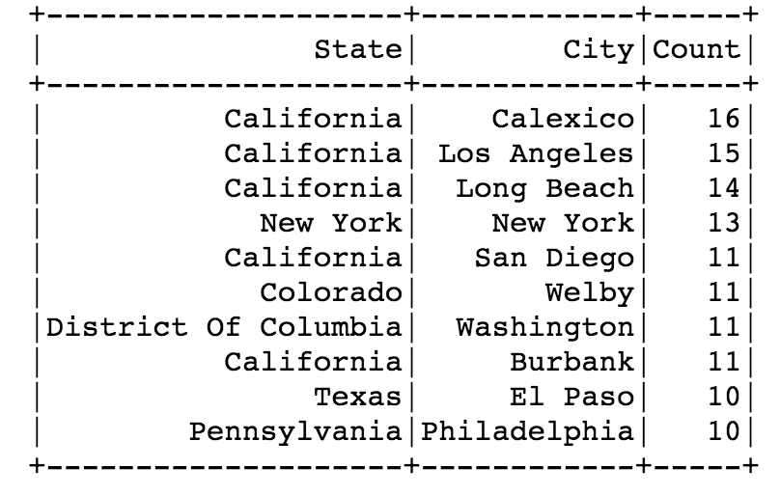
MOST POLLUTED CITIES HAVING AT LEAST 3 POLLUTANTS WITH AQI>80
MOST POLLUTED CITIES FOR CONSECUTIVE YEARS

Slide 8
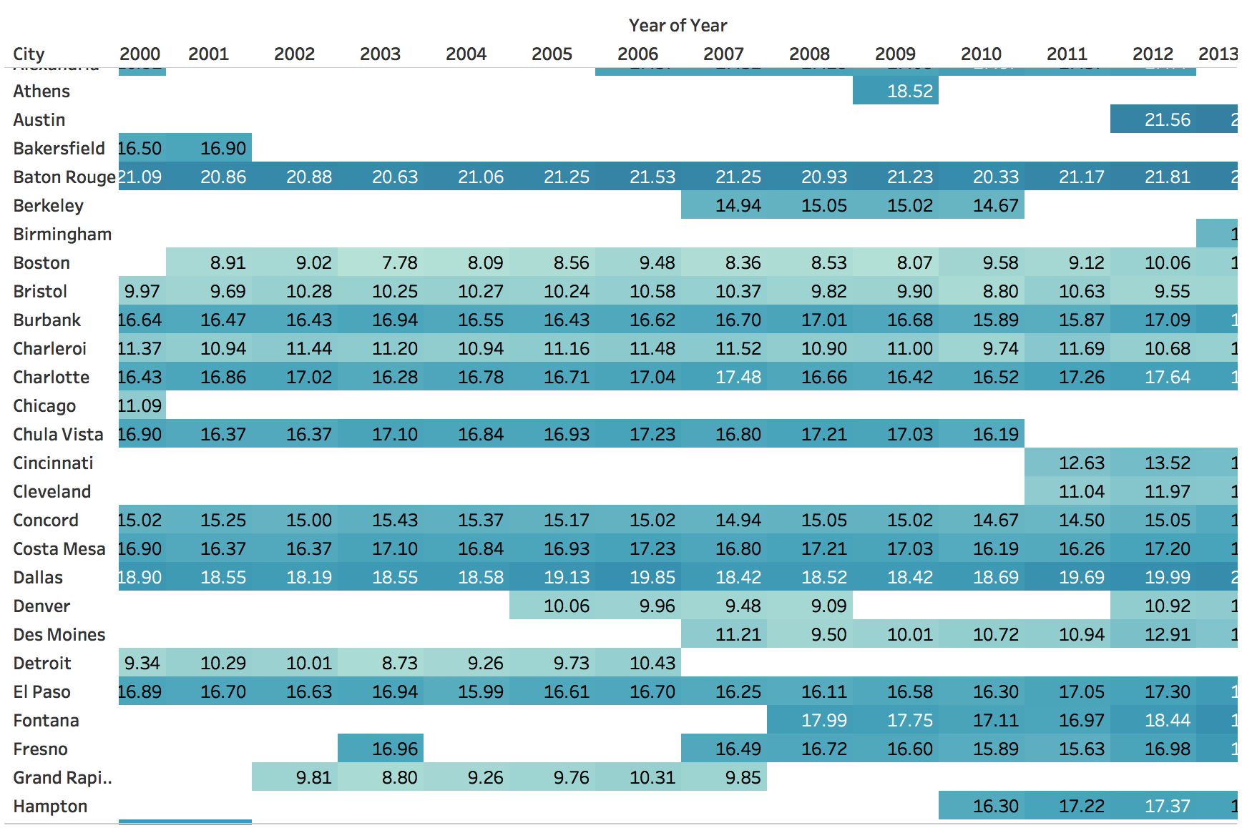
AVERAGE YEARLY TEMPERATURE FOR EACH CITY

Slide 9
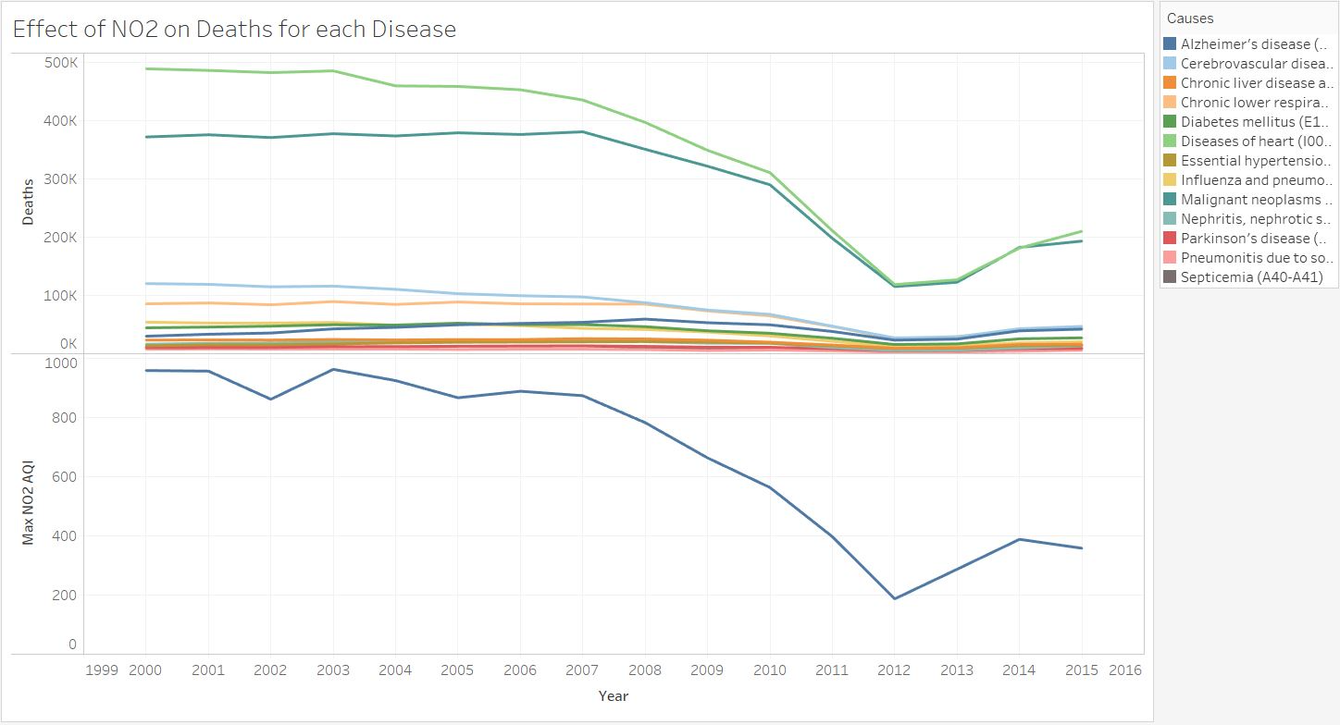
EFFECT OF NO2 ON DEATHS FOR EACH DISEASE

Slide 10
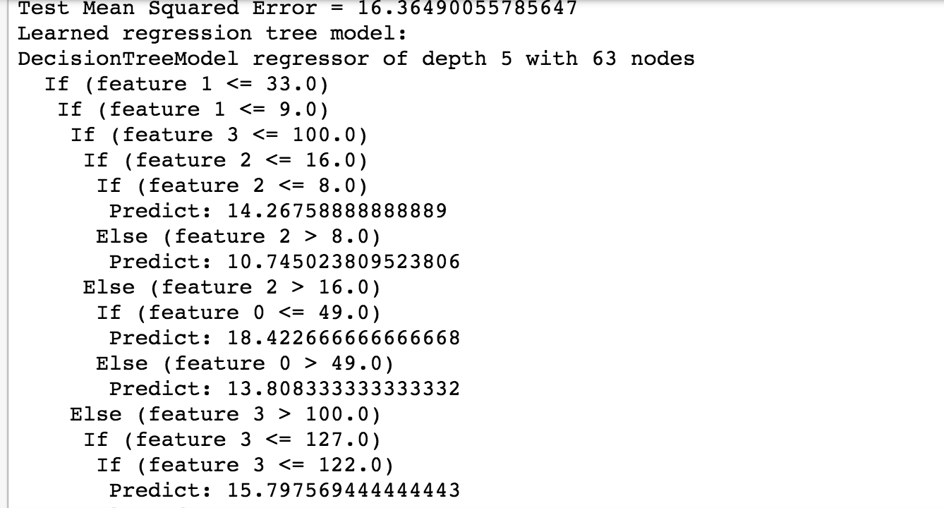
PREDICTED TEMPERATURE VALUES BASED ON POLLUTION LEVELS

Slide 11
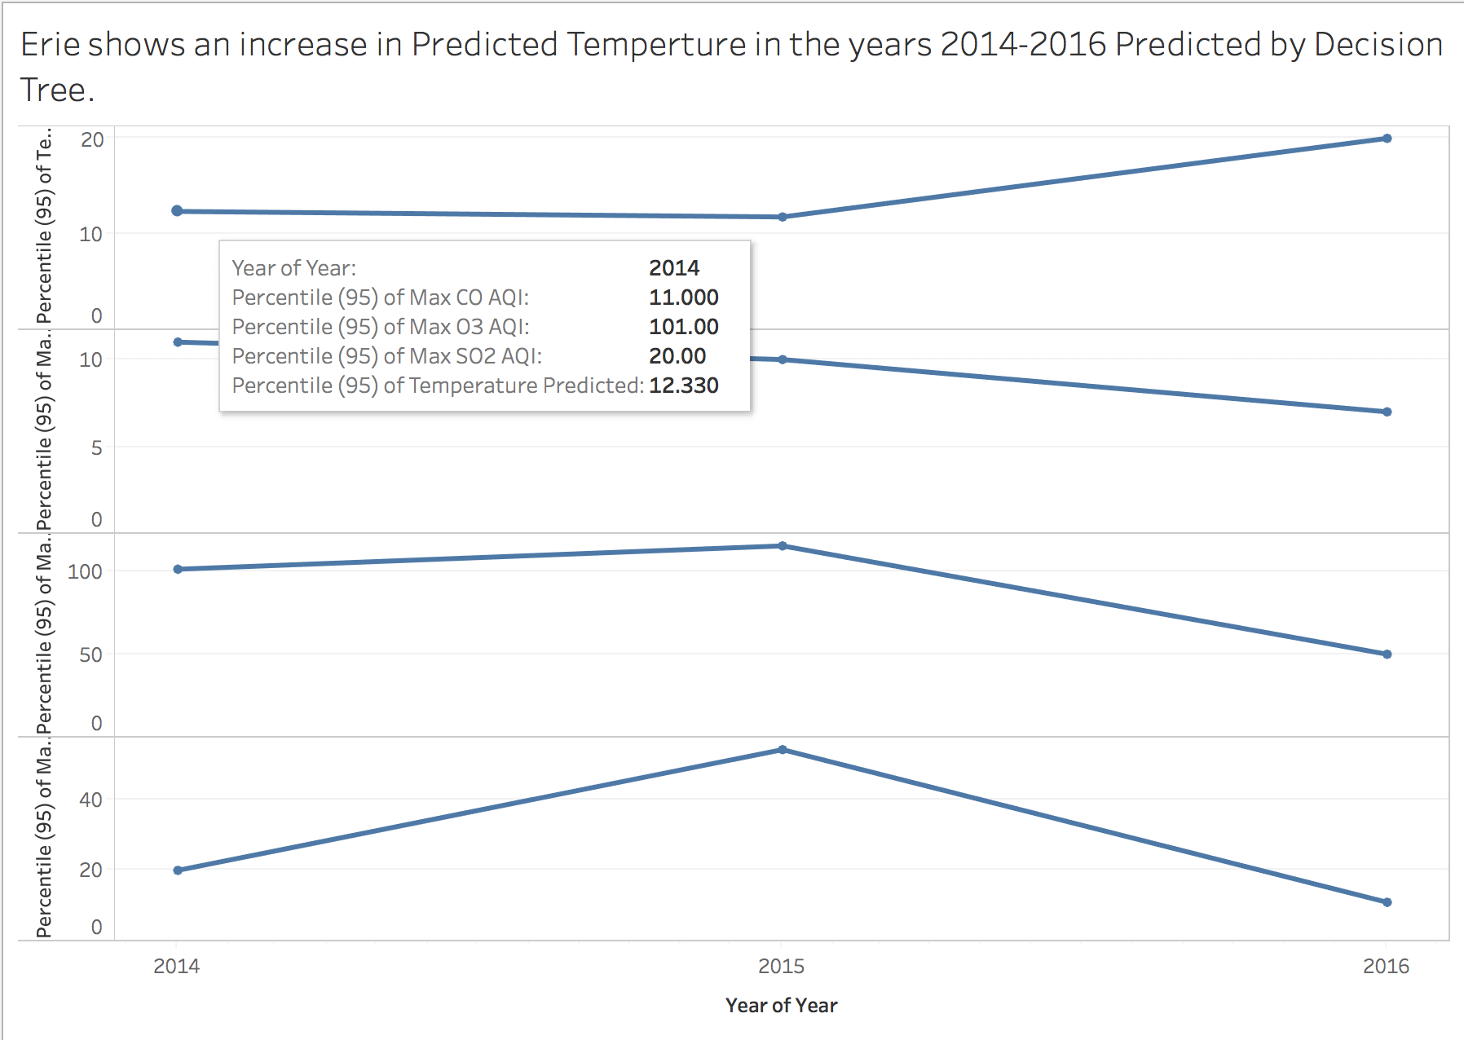

Slide 12
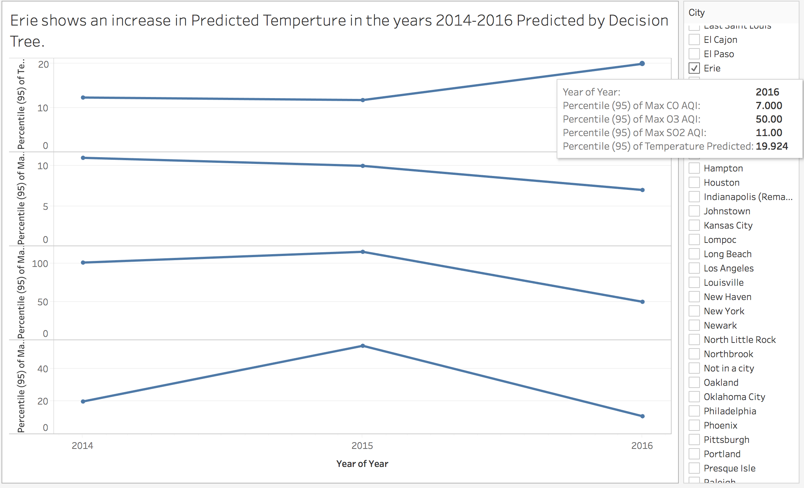

Slide 13


REAL TIME TWITTER SENTIMENT ANALYSIS FOR “CLIMATE CHANGE”
Disruptive climate events are often reflected in social media. Monitoring changes in these sentiments during and after the disasters can reveal awareness of people with respect to climate change and mental health.
We used Ensemble Algorithm with multiple models like Logistic Regression, BernoulliNB Classifier, Naive Bayes and synthesized their results into a single score in order to compare and improve the accuracy of predictive analytics.
Example of tweets with their sentiment value derived:
Negative
RT @democracynow: Trump Unveils National Security Strategy, Ignoring Climate Change Threat.
Positive
NASA and NOAA are still talking about climate change. That’s notable. - The Washington Post.
Technologies Used: 1. Training the data : Sklearn Library 2. Streaming the Tweets : Tweepy 3. Plotting the real time tweets: Matplotlib

Slide 14
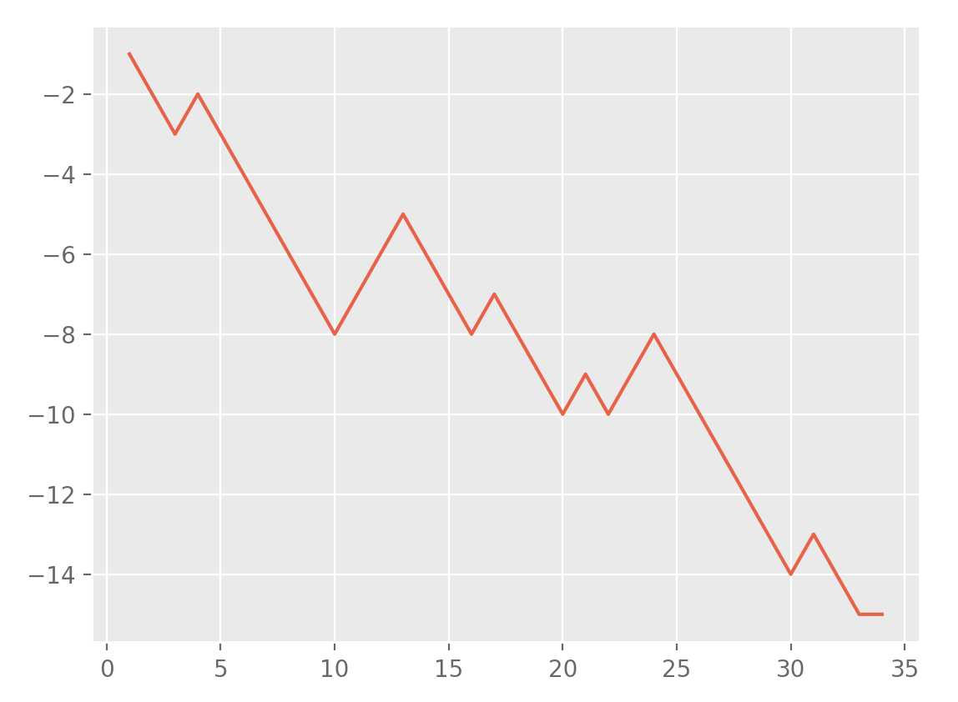
SENTIMENT ANALYSIS FOR CLIMATE CHANGE
Sentiment Value
Time(Seconds)

Slide 15
LESSONS LEARNED
Data Cleaning, removing non-informative attributes, feature engineering using Spark on Zeppelin (NYU HPC)
Integrating Jupyter Notebook with PySpark, Spark and R.
Applying machine learning algorithms to the Big Data files to make future predictions using Spark MLlib.
Gathering tweets using Tweepy Library and performing Dynamic Sentiment Analysis using Machine Learning models. Plotting the results using Matplotlib.

Slide 16
PROBLEMS WE RAN INTO
Connection issues with NYU HPC while using Zeppelin
Integrating Jupyter notebook with Spark, PySpark and R on Windows
Data type casting problems for columns of Spark DataFrames
Permission issues in collecting Tweets for a timeline of more than one week
Feature Engineering and identifying the important attributes from all the datasets, to train the Decision Tree

Slide 17
CONCLUSION
There was a strong correlation between the pollution levels, temperature increase and death counts for certain cities and diseases, especially for Cardiovascular diseases
There were a few outliers for which temperature and deaths decrease even though pollution levels increased
The average increase in temperature across the last 4 years was about 2C
There is an increasing awareness about climate change among Twitter users
Our website: http://www.vikrambajaj.me/bigdata

